Slide 1
EFB 390 Recitation
Announcements:
Carrying capacity assignment due today (Tues 10/25)
Guest presenter Thursday – submit question on Blackboard before lecture
Recitation slides Blackboard?
Today:
Last week lecture review
North American Model discussion
Poll – who hunts?
Notes:
delta N = (B – D) + (I – E)
Little b, d are birth and death rates
ASSUMPTION: The number of Births and Deaths is proportional to N.
Every female gives birth to the same number of offspring?
Every female has the same probability of giving birth?
Every female has the same probability of giving birth to the same distribution of offspring?
A fixed proportion of all individuals dies?
Every individual has the same probability of dying?
the distribution of probabilities of dying is constant?
LAMBDA, exponential growth!
λ is rate of growth (or decrease)
If d>b, λ<1
If b>d, λ>1
Sources of variation:
Environmental stochasticity
Demographic stochasticity – always leads to small probability of extinction
Density dependence - WOLVES
- rate of a parameter, is (a) NOT constant, and (b) dependent on total population (or density) N
Logistic growth (graph)
Other important terms:
Fecundity - # births per female over unit of time
Obligate

Slide 2
The North American Model
Lacey Act (1900)
Made market hunting illegal nationwide, prohibits interstate transport
Migratory Bird Treaty Act (1918)
Initially between US and Canada → other nations including Mexico & Japan
International protection for birds from market hunting
Pittman-Robertson Act and Dingell-Johnson Act
Excise tax on hunting, shooting, archery, and angling equipment and boating fuel
Generates funding for wildlife and habitat conservation
Funds used by state wildlife agencies
For non-hunters: Federal Duck Stamp
98% goes to purchasing habitat or acquiring easements
National Wildlife Refuge System
Notes:
Anyone can buy a stamp!!! Also NYS habitat access stamp and trail access patch

Slide 3
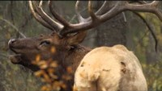
Discussion – Tenets NAM
Fill in the blank on model tenets
Historical context
Agree/disagree
Are terms well defined?
Discussion guidelines:
Everyone please participate
I will call on people who aren’t participating
Disagree without being disagreeable
Notes:
Any sort of wildlife management professional will need to be familiar with the model and comfortable talking about it so my goal for this conversation is to give you all the forum to get comfortable discussing NAM and articulating your opinions about it
YOUR discussion I’m here to guide
For me, I like to have a few moments to collect my thoughts and take notes would you like to take one minute to think, write down ideas before going into discussion on each tenet or would you rather go for it?

Slide 4
Wildlife resources are a public trust
What does it mean?
Are terms well defined?
Agree/disagree
Historical context
Great Britain wildlife de facto private property of landowners
US colonies English common law, king owned public resources, after independence trustee status → states
Notes:
Not privately owned, managed by the state on behalf of public
Access to wildlife?

Slide 5
Markets for game are eliminated
What does it mean?
Are terms well defined?
Agree/disagree
What about furbearers?
Historical context
unregulated wildlife trafficking in the 19th century led catastrophic population declines
Which species are examples?
Notes:
Dead wildlife products shouldn’t be commodified, can’t buy wild deer to eat
What about furbearers??
Clear exceptions (commercial fish etc)
Example spp: beavers, sea otters, passenger pigeon

Slide 6
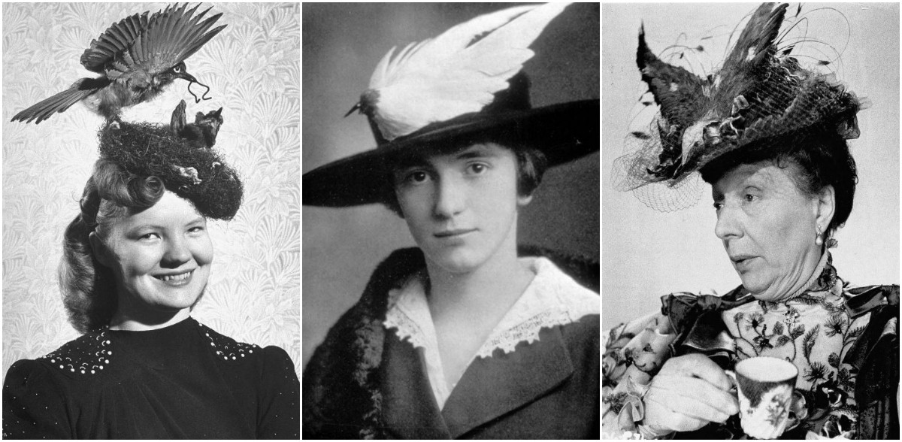
Frank Chapman's 1886 Feathered Hat Census
40 Aves spp. on two walks in Manhattan!
https://web.stanford.edu/group/stanfordbirds/text/essays/Plume_Trade.html
BIRD SPECIES | # HATS | BIRD SPECIES | # HATS
Grebes | 7 | Blue Jay | 5
Green-backed Heron | 1 | Eastern Bluebird | 3
Virginia Rail | 1 | American Robin | 4
Greater Yellowlegs | 1 | Northern Shrike | 1
Sanderling | 5 | Brown Thrasher | 1
Laughing Gull | 1 | Bohemian Waxwing | 1
Common Tern | 21 | Cedar Waxwing | 23
Black Tern | 1 | Blackburnian Warbler | 1
Ruffed Grouse | 2 | Blackpoll Warbler | 3
Greater Prairie Chicken | 1 | Wilson's Warbler | 3
Northern Bobwhite | 16 | Tree Sparrow | 2
California Quail | 2 | White-throated Sparrow | 1
Mourning Dove | 1 | Snow Bunting | 15
Northern Saw-whet Owl | 1 | Bobolink | 1
Northern Flicker | 21 | Meadowlarks | 2
Red-headed Woodpecker | 2 | Common Grackle | 5
Pileated Woodpecker | 1 | Northern Oriole | 9
Eastern Kingbird | 1 | Scarlet Tanager | 3
Scissor-tailed Flycatcher | 1 | Pine Grosbeak | 1
Tree Swallow | 1

Slide 7
Allocation of wildlife is by law
What does it mean?
Are terms well defined?
Agree/disagree
Historical context
Public access to wildlife in NA vs nations where access is reserved for those with special privilege (e.g. aristocracy)
1897 NY State Assembly passed Adirondack Deer Law
Outlawed jacklighting deer at night and shooting deer after driving them into deep water with hounds
Laws to protect populations and promote ethical behavior
Notes:
State gets to decide who has access to wildlife, when/how/why, state regulates what’s allowed

Slide 8
Wildlife can be killed only for a legitimate purpose
What does it mean?
Are terms well defined?
Agree/disagree
Historical context
Post American Revolution, post Civil War
American as the “true sportsmen”
Notes:
You couldn't just go out and destroy wildlife for any reason
Legitimate? Are traditional reasons legitimate?
Prairie dog shooting, trophy hunting, coyote/predator hunting
“sportsman”
does so primarily for the pursuit or chase;
affords game a “sporting” chance (fair chase);
seeks knowledge of nature and the habits of animals;
derives no financial profit from game killed;
will inflict no unnecessary pain or suffering on game; and
will not waste any game that is killed.

Slide 9
Wildlife is considered an international resource
What does it mean?
Are terms well defined?
Agree/disagree
Historical context
Wildlife require coordinated regulations because they cross political boundaries
Migratory Bird Treaty Convention 1916
Notes:
one state shouldn't take unilateral action regarding wildlife that migrates across international boundaries, and what gives rise to international treaties like the ones for migratory birds
Pretty straightforward

Slide 10
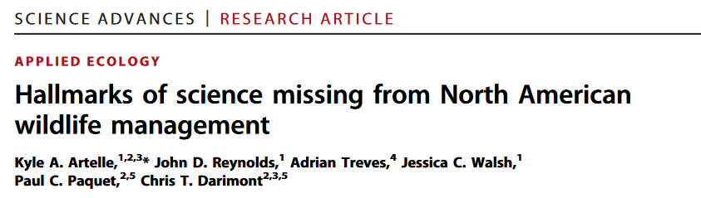
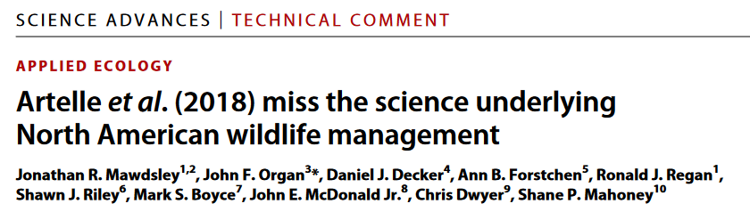
Science is the proper tool to discharge wildlife policy
What does it mean?
Are terms well defined?
Agree/disagree
Historical context
Exclude non-western knowledge
Prevent politics & business interests from managing for their benefit
Notes:
Western science should determine wildlife management practices
Agree/disagree
In Colorado it went to the popular vote whether or not to repopulate wolves

Slide 11
Democracy of hunting is standard
What does it mean?
Are terms well defined?
Agree/disagree
Barriers to access?
Historical context
European model allocated wildlife by land ownership and privilege
Access for all would result in societal benefits – hallmark of democracy
Notes:
no class distinctions at all about having access to wildlife. That every citizen should have access to wildlife. And in a perfect world, of course, their access should be equal, and unimpeded
Agree/disagree: privilege and land ownership?
What are barriers to access?

Slide 12
Case Study: Mountain Lions (Future Ecologies)
Human/wildlife conflict
What was the law for livestock depredation?
Legal state removal after depredation
Case with female cat and kittens → livestock owners refused to protect them
What was the cultural influence?
negative view of predators, Roosevelt era viewpoint
What was the political/financial influence?
politics lean towards hunter constituency
Notes:
Cat and kittens were after chickens (who were not in danger), cat was killed, kittens kill alpacas, same property had two additional removals in the same month
NAM - Ammunition/gun manufacturers demanded money be spent on conservation

Slide 13
So, does it work? If not, how do we fix it?
Did the NAM really save wildlife?
Potential problems?
Colonial
Emphasizes game species
Excludes non-consumptive users
Political and cultural conflict
Humans as “custodians” and not part of nature
Commodifies wildlife as “resources”
Old, perhaps time for an update?
Alternatives?
Indigenizing the NAM
Other wildlife governance principles?

Slide 14
Submit questions on Blackboard before lecture Thurs for Neil Patterson guest lecture
Assignment due next Tuesday 11/1 "Science in management - the debate"

